Slide 1
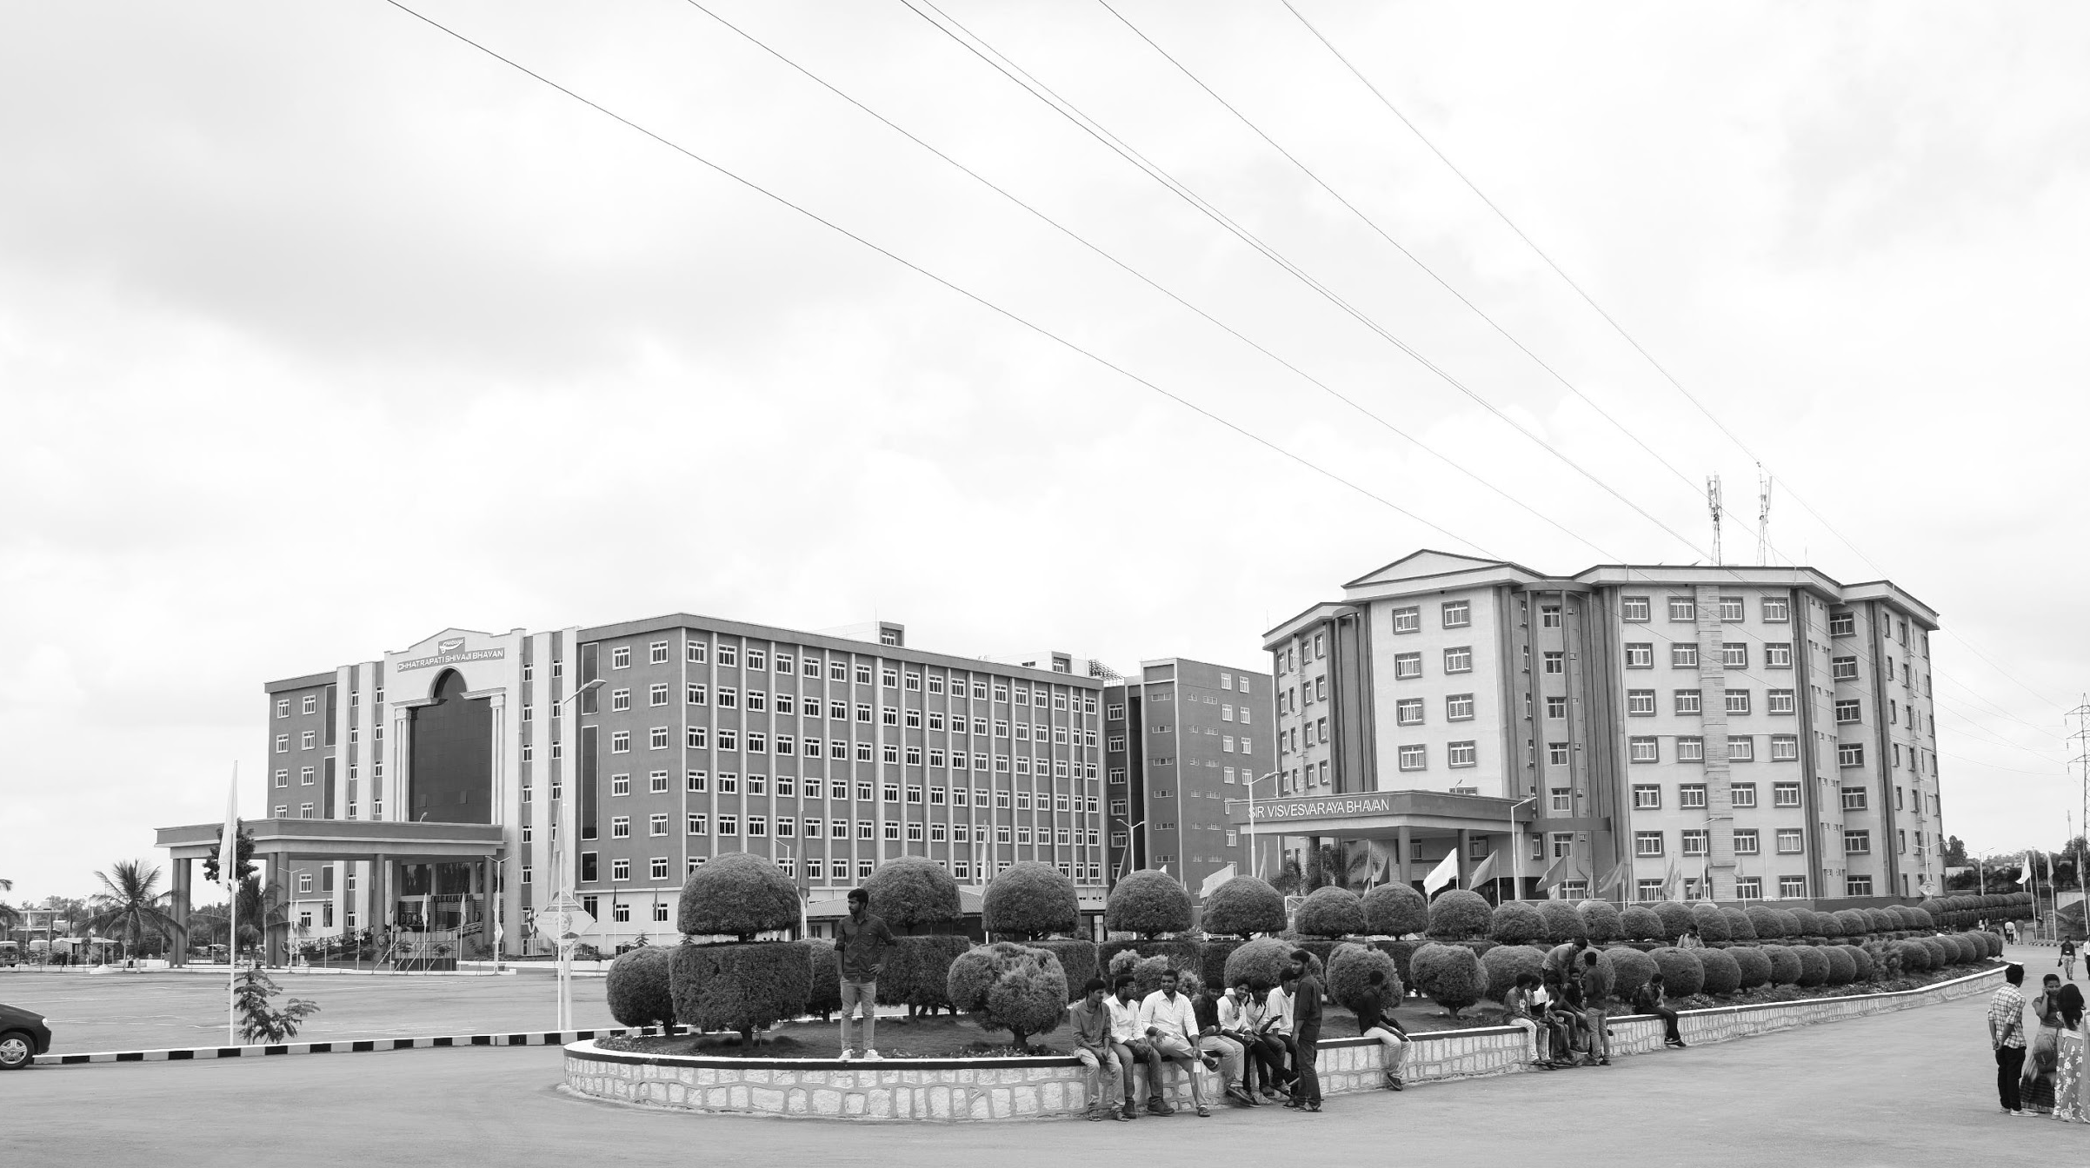

MULTIBAND REFLECTIVE POLARIZATION CONVERTER USING METASURFACE
AY 2020-24
GITAM UNIVERSITY
Major Project
Project ID: XX
A University should be a place of light, of liberty, and of learning.
Department of Electrical Electronics and Communication Engineering
Project Team:
R S S S Snigdha
K S P Mahadev
MD Akram
Project Mentor:
Dr. S Durga Padmaja Bikkuri
www.gitamedu.com

Slide 2

Project Group – Details
Photo
Track
Roll No
Name
Photo
EECE AI/ML
BU21EECE0100200
R S S S Snigdha
Photo
EECE AI/ML
BU21EECE0100097
K S P Mahadev
Photo
EECE
BU21EECE0100083
MD Akram

Slide 3
Objective and Goals
Objective
The main objectives of our project include:
Design a metasurface-based polarization convertor which can convert a linear polarized incident EM wave into circular polarized during reflection at a single frequency in 4-8 GHz range.
Extend the operation of the converter to multiple frequency.
Analyze the Polarization conversion ability of the surface from the simulated results.
Goals
Main goals
Achieve precise and efficient conversion.
Expand the metasurface capability across multiple frequencies.
Validate the performance through simulations, ensuring the results meet our expectations.

Slide 4
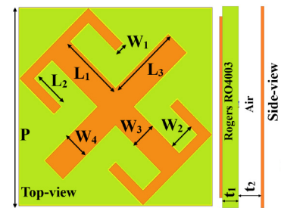
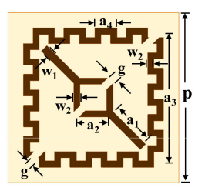
Literature Survey
TITLE | AUTHOR and YEAR | STRUCTURE | KEY FINDINGS
A Low-Profile Multifunctional Metasurface Reflector for Multiband Polarization Transformation. | Soumendu Ghosh , Jeet Ghosh , Moirangthem Santosh Kumar Singh and Abhishek Sarkhel 2023 |  | Metasurface Design: multifunctional. Broadband Polarization Conversion: Tri-Band LP-to-LP Conversion: 5.47-5.68 GHz, 7.86-8.84 GHz, and 14.68-16.83 GHz. Quad-Band LP-to-CP Conversion: 5.30-5.41 GHz, 5.77-7.58 GHz, 9.27-13.91 GHz, and 17.53-19.59 GHz. Radar Cross-Section (RCS) Reduction: 5.85-5.95 GHz, 9.2-10.3 GHz, and 16.6-18.5 GHz.
Multi-Band Multi-Functional Metasurface-Based Reflective Polarization Converter for Linear and Circular Polarizations | RAHUL DUTTA , JEET GHOSH , ZHENGBAO YANG ,AND XINGQI ZHANG, 2021 |  | Multiband Polarization Conversion:linear-to-orthogonal linear 4.3 GHz, 7.2 GHz, 12.3 GHz, and 15.15 GHz linear-to-circular and circular-to-linear: 4 GHz, 4.75–5.95 GHz, 8.35–8.8 GHz, and 14.35–14.6 GHz. Design and Resonance Mechanism: The multiband operation is attributed to multiple resonances occurring within the structure, which is based on a meandered square ring and diagonal split strip resonator.

Slide 5
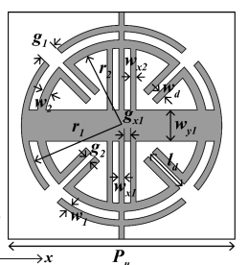
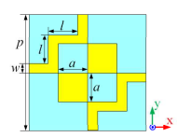
Literature Survey
TITLE | AUTHOR and YEAR | STRUCTURE | KEY FINDINGS
Ultrathin Single Layer Transmissive Dual-Band Linear to Circular Converter for Non-Adjacent Dual Orthogonal Circularly Polarized Antenna | SOUMIK DEY , SUKOMAL DEY. 2024 |  | Dual-Band Transmissive Polarizer:Designed on a single-layer, ultra-thin dielectric substrate (0.51 mm thick Taconic TLY-5). Frequency and Angle Stability:The LTCP achieves polarization conversion at 11.2 GHz and 22.75 GHz with oblique angle stability up to 35°.
Simultaneous Transmission and Reflection Mode Linear-to-Circular Polarization Conversion Using a Single Metasurface | Debidas Kundu; Dhrubajyoti Bhattacharya; Debashree Pathak 2021 |  | Dual-Mode Linear-to-Circular Polarization Conversion (LCP):The metasurface is designed to achieve linear-to-circular polarization (LCP) conversion in both transmission and reflection modes simultaneously.

Slide 6
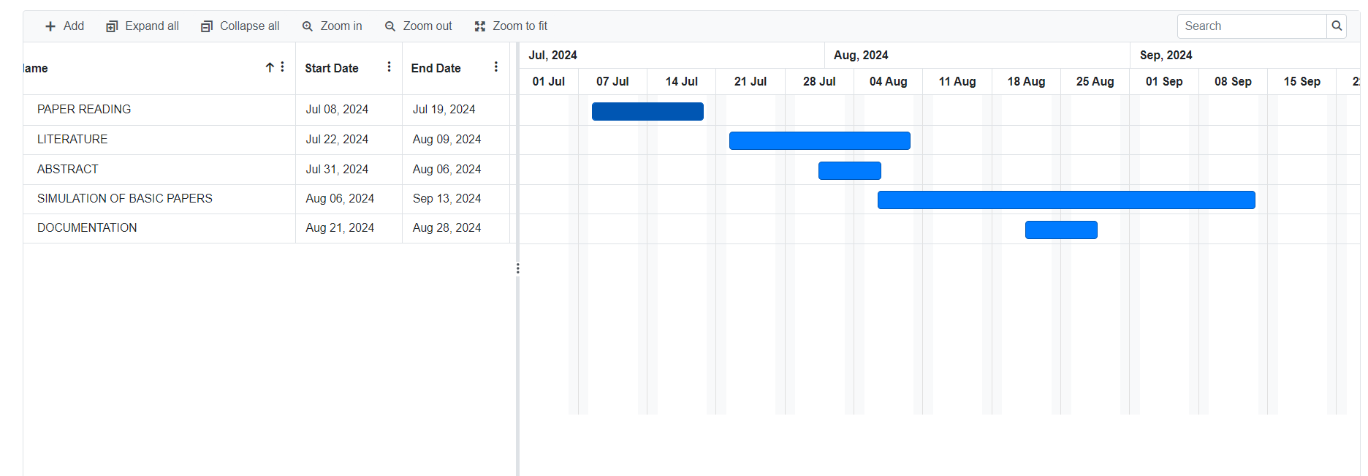

Project Plan
EXPLORATION OF SIMULATION TOOLS

Slide 7
Analysis - SWOT
Strengths
Weaknesses
01. Compact-Design
02. Potential for Broad Impact
01. Narrow Operational Focus
02. Dependency on Metasurface Performance
Threats
Opportunities
01. Environmental Sensitivity
02. Manufacturing challenges
O1. Expanding to Multiband Systems
02. Collaboration with Industry

Slide 8
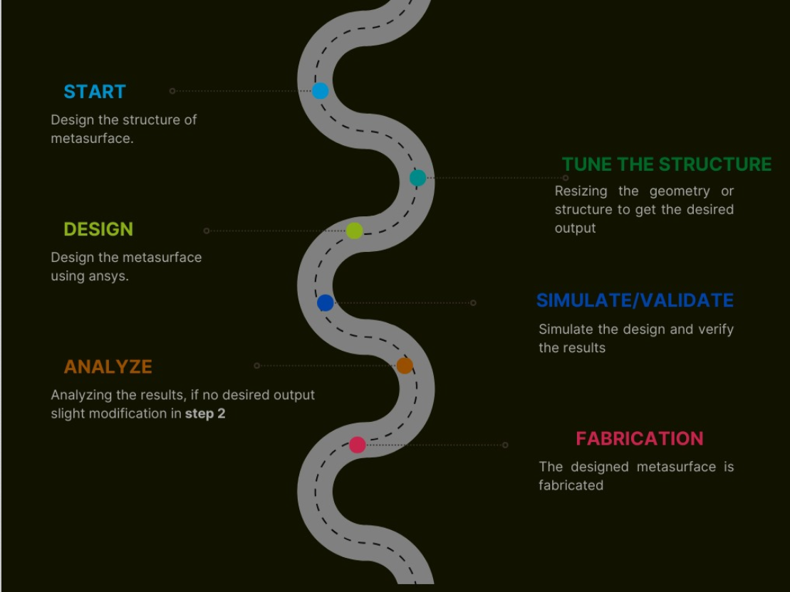
ROAD MAP

Slide 9
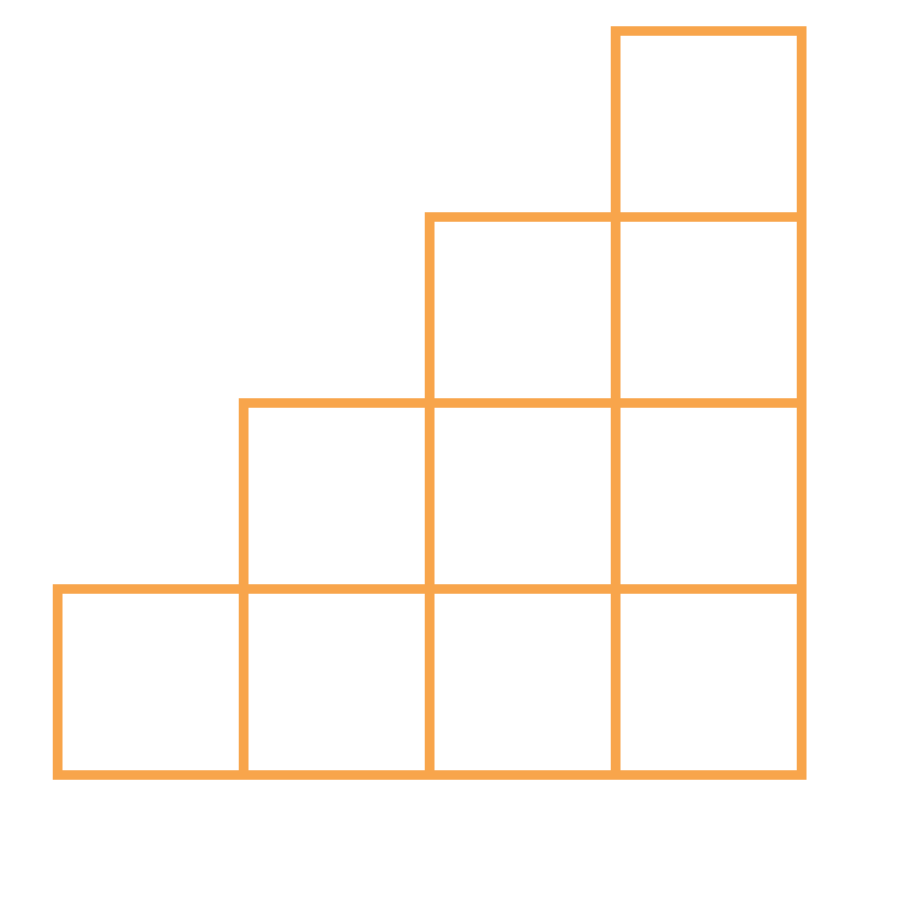
THANK YOU

